Slide 1
Spam Email Detection Using Support Vector Machine
Presented By: Supervised By:
Sijan Poudel Assistant Professor Bikash Balami
Notes:
Good afternoon sir, I’m Sijan Paudel, and I’d like to thank Assistant Professor Bikash Balami, the Head of Department, and all faculty members for their support as I present on ‘Spam Email Detection Using Support Vector Machine.

Slide 2
Overview
Introduction
Problem Statement
Objective
Literature Review
Methodology
Results and finding
Conclusion and further recommendations
Notes:
This is the overview of todays presentation

Slide 3
Introduction
Email is a vital tool for communication in our daily lives, both personally and professionally.
Spam emails, or junk emails, are unsolicited messages sent in bulk. They often contain advertisements, phishing attempts, or malicious content.
Effective detection and filtering systems are crucial to addressing the problem of spam.

Slide 4
Objective
To Preprocess and convert email text data into a numerical format.
To Train an SVM model to classify emails as spam or non-spam.

Slide 5
Problem Statement
Significant challenge impacting productivity and security in digital communication.
Traditional rule-based spam detection struggles to adapt to evolving spamming tactics.
Results in ineffective filtering and increased vulnerabilities.

Slide 6
Literature Review
Spam emails[1] have become a significant problem, filling inboxes with unwanted messages and posing security risks like phishing and malware. Traditional methods for detecting spam, which rely on fixed rules and patterns, often struggle to keep up with the ever-evolving tactics of spammers
Support Vector Machines (SVM)[2] are a powerful machine learning algorithm known for their effectiveness in classification tasks, especially with high-dimensional data such as text
Spam email [3]detection has significantly progressed from rule-based and statistical methods to sophisticated machine-learning techniques. Traditional approaches, such as rule-based filters and Bayesian methods, used predefined patterns and statistical probabilities to identify spam.

Slide 7
Methodology
Dataset Preparation
Data Preprocessing
Feature Extraction
Model Training
Model Evaluation
Notes:
These are the steps to complete seminar

Slide 8
Implementation Tool and Libraries Used:
Python
Scikit-learn
Pandas
Numpy
Matplotlib
TensorFlow and Keras

Slide 9
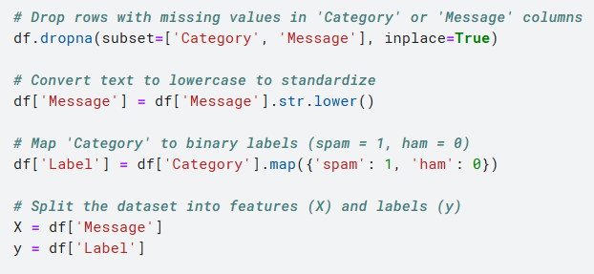
Data Preprocessing

Slide 10
Split the Dataset

Slide 11
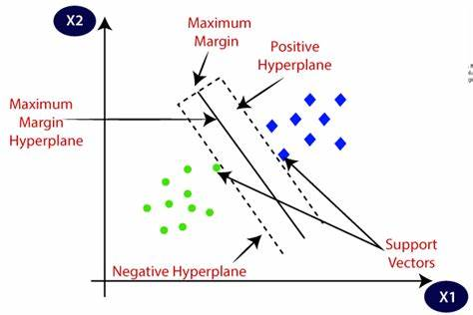
Support Vector Machine
Notes:
Data Preprocessing:
Convert raw data into a numerical format, often using techniques like TF-IDF for text data.
Selecting a Kernel:
Choose a kernel function (linear, polynomial, radial basis function) to transform the data into a higher-dimensional space if necessary.
Training the Model:
Use the training dataset to find the optimal hyperplane by maximizing the margin between classes.
Hyperparameter Tuning:
Adjust parameters like C (regularization parameter) and gamma (kernel coefficient) to improve model performance.
Model Evaluation:
Assess the model's performance using metrics such as accuracy, precision, recall, and F1 score.

Slide 12
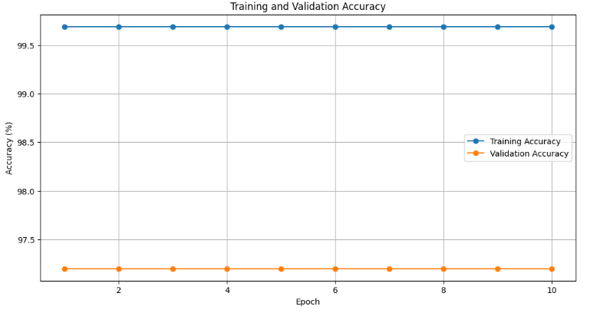
Result and Findings 1. Training and Validation Accuracy Overfitting occurs when the spam detection model performs exceptionally well on the training data but poorly on new, unseen messages, indicating it has learned specific details rather than general patterns.

Slide 13
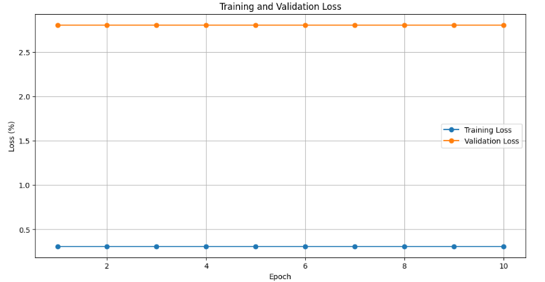
2. Training and Validation Loss

Slide 14
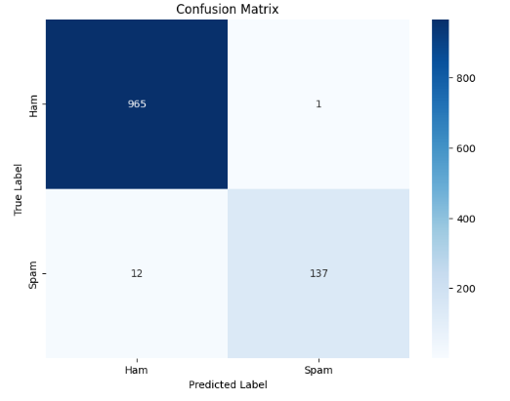
Confusion Matrix

Slide 15
Model Performance Measure
Precision | Accuracy | Recall | F1 Score
99.28% | 98.83% | 91.95% | 95.47%
From this values we can conclude that the svm model well accurately.

Slide 16
Conclusion and Future Recommendations
Explored SVM with TF-IDF for email spam detection.
Applied a linear SVM classifier.
Achieved notable performance in classifying emails into spam and non-spam.
Exploring Other Models.

Slide 17
References
[1] M. Singh, R. Pamula, and S. k. shekhar, “Email Spam Classification by Support Vector Machine,” in 2018 International Conference on Computing, Power and Communication Technologies (GUCON), 2018, pp. 878–882. doi: 10.1109/GUCON.2018.8674973.
[2] T. M. Ma, K. YAMAMORI, and A. Thida, “A Comparative Approach to Naïve Bayes Classifier and Support Vector Machine for Email Spam Classification,” in 2020 IEEE 9th Global Conference on Consumer Electronics (GCCE), 2020, pp. 324–326. doi: 10.1109/GCCE50665.2020.9291921.
[3] S. O. Olatunji, “Improved email spam detection model based on support vector machines,” Neural Comput. Appl., vol. 31, pp. 691–699, 2019.

